Slide 1
MANUFACTURING SYSTEMS

Slide 2
The goal is to create and add value to the inputs during the transformation.
Production managers refer to them as the “five M’s”: men, machines, methods, materials, and money.

Slide 3
  Manufacturing Industries
Manufacturing industries can be grouped into either Primary, Secondary or Tertiary industries.
  Primary Industries exploit natural resources e.g. agriculture or mining.
  Secondary Industries take the output of primary industries and convert them into consumer goods. Manufacturing is mostly concerned with this category but construction can also be included here.
  Tertiary Industries contribute to the service sector of the economy. e.g. Banks, insurance.

Slide 4
  Generic Manufacturing Strategies
Deciding on the strategy used to produce a product is a complex one and it involves strategic decisions by the management.
There are different ways of offering a product or service from a company.

Slide 5
  Generic Manufacturing Strategies (cont’d)
Make to Order
  Products are designed, produced and delivered to customer specifications in response to an order.
  Examples are custom-tailored clothes, custom-built homes, and component parts for a machine.
  The important issues here are to meet the needs of the customer and to complete the order in the minimum amount of time.

Slide 6
  Generic Manufacturing Strategies (cont’d)
Make to Stock
Products are designed and produced for a ‘standard’ customer in anticipation of demand.
The items are stored and the consumer chooses from a range of items that are available.
Examples of this type of product would be an MP3 player, or milk.
The main issues related to forecasting the demand for the item and maintaining the correct amount of items in stock.

Slide 7
  Generic Manufacturing Strategies (cont’d)
Assemble to Order
In this case, a base unit or module is produced onto which options can be added according to the specification of the customer.
A computer motherboard and cabinet can have different memory modules, hard drives, processors, etc. fitted during assembly to make a custom-built product.

Slide 8
  Types of Production Processes
The choice of the processes used to make an item depends on the characteristics of the product and the volume of the product being made.
Production processes can be classified into projects, batch production, mass production, and continuous production.

Slide 9
  Types of Production Processes (cont’d)
A Project
It takes a long time to complete, involves a large investment of resources and produces one item at a time to a customer order. Examples include
Roads,
Construction projects,
Aircraft manufacturing
New product development e.g. iPhone where the outcome of the project is a prototype iPhone.

Slide 10
  Types of Production Processes (cont’d)
Batch Production
It involves moving groups of the product through the manufacturing process in groups or batches.
The volume is relatively low and demand for the items can fluctuate. Examples are
Bakeries,
Cheese making

Slide 11
  Types of Production Processes (cont’d)
Mass Production
It produces large volumes of a standard product for a mass market. The demand for the product is stable and high. Examples are
Cars,
Computers
Fast food such as burgers
There is usually a degree of automation involved.

Slide 12
  Types of Production Processes (cont’d)
Continuous Production
It is used for very high volume products. These are highly standardized and are produced using highly automated systems. Examples are
Electricity,
Treated water,
Foodstuffs,

Slide 13
  The Product Process Matrix (cont’d)
The relationship between these issues is often described using the product-process matrix shown below.
It shows the relationship between the levels of volume and standardization of a product and its manufacturing process.

Slide 14
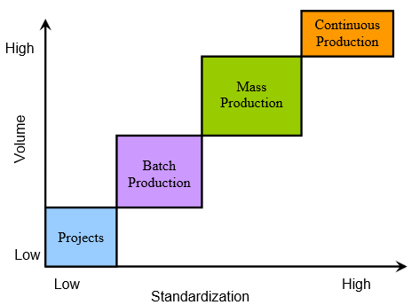
  The Product Process Matrix (cont’d)

Slide 15
  Key Success Factors in Manufacturing Competitiveness
In a modern enterprise, all of the functions are integrated to increase efficiency.
Companies usually choose to compete on one of the four areas listed below:

Slide 16
  Key Success Factors in Manufacturing Competitiveness
Competing on Cost
Companies that compete on cost try to eliminate all waste in the production process.
Usually, the production process is high-volume, standardized and automated.

Slide 17
  Key Success Factors in Manufacturing Competitiveness
Competing on Quality
To compete on quality, quality needs to be viewed as a means to please the customer, not just a way to avoid mistakes or defects.
Taking a car as an example, it may involve reliability (Toyota), a premium product (e.g. Mercedes), etc.
Customers are often pay more for a product they believe is of higher quality than its competitors.

Slide 18
  Key Success Factors in Manufacturing Competitiveness
Competing on Speed
To compete on speed, a company must have close contact with both suppliers and customers.
A common example is McDonald's where a standard range of products (Happy Meal etc.) is available for consumption without delay.

Slide 19
  Key Success Factors in Manufacturing Competitiveness
Dell computers product is ordered online and assembled to order and delivered in a few days.
The company has close contact with the suppliers of the component parts and these are delivered to the factory exactly when they are needed and the assembled machine leaves the factory as soon as it is tested and packed.

